Slide 1
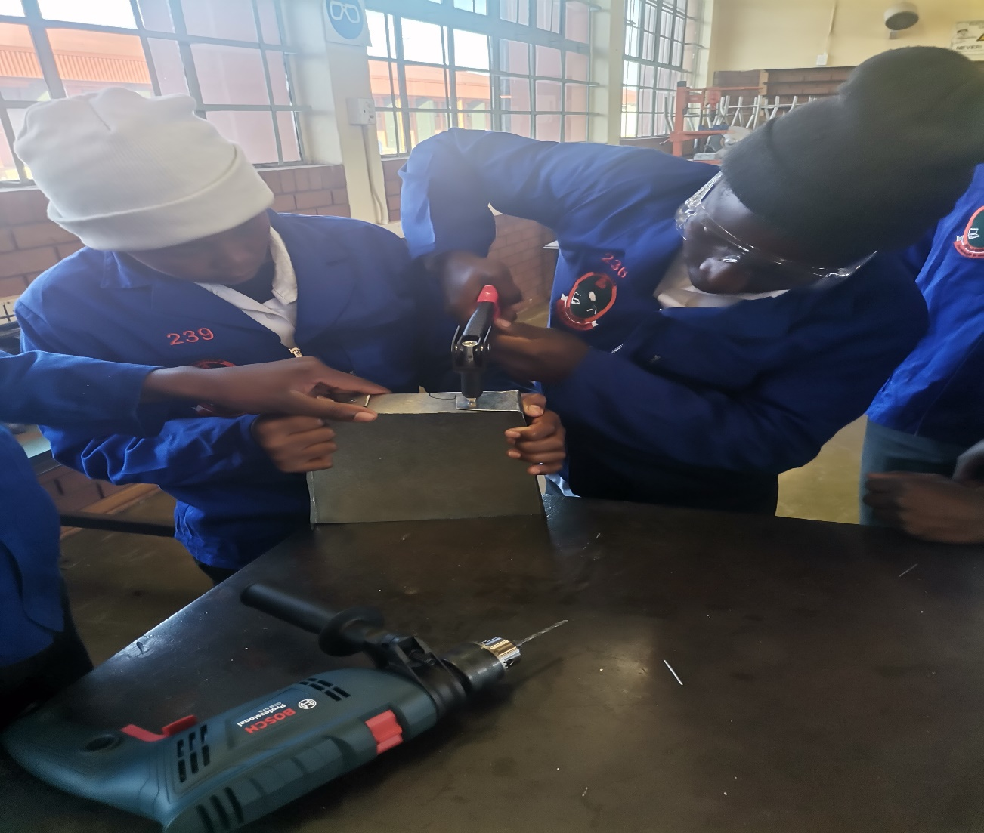
Metalwork Maintenance
Video : Introduction to Metalwork
https://youtu.be/VlFsoNVeVx8?si=qL-1_ynbpJ5hHK1O

Slide 2
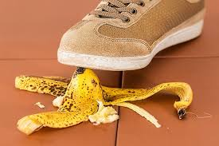
Metalwork Maintenance
Workshop Safety
Unsafe Acts
Unsafe speed.
No authority-failure to secure or warn.
Safe devices not working
Arranging or placing objects in an unsafe potion.
Fooling around, teasing, abusing.
Equipment handled unsafely or in the wrong way.
Adjusting or working on moving equipment.
Chance taking.
Taking up unsafe position.
Safety equipment and protective clothing not being used.

Slide 3
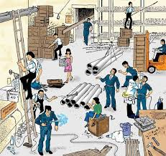
Unsafe Conditions
Construction unsafe
Order of planning is bad.
No guard.
Dangerous condition-rough, sharp, slippery.
Inadequate guarded machinery.
The layout, exits, walkways etc.
Illumination unsafe.
Overcrowding.
No personal protective equipment.
Safe ventilation non-existent.
Video :
https://youtu.be/aRF1chipKQ8?si=3SyZ84Q4IwZnSRBR
Feedback : Activity

Slide 4
Kwa Thema Skills School
Subject : Maintenance Marks: 10
Grade : Year 1 Time : 30 mins
Date : / / 2024
Question:1
1.State whether the following statements are Unsafe Acts or Unsafe Conditions.
1.1 Taking up unsafe position. _________________
1.2 No guard. ___________________
1.3 Overcrowding. ___________________
1.4 Construction unsafe. ___________________
1.5 No authority. __________________
1.6 Safe ventilation non-existent. ___________________
1.7 No personal protective equipment. __________________
1.8 Unsafe speed. ____________________
1.9 Order of planning bad. ___________________
1.10 Chance taking. _______________________

